Slide 1
Independence and its Heroes
Independence…remained by far the most important moment
for the new nations that emerged; representations of its
heroes and martyrs have become talismans or icons
signifying those beliefs, and reinterpreted with reverence, or
with irony, by artists in the twentieth century for whom national
or Latin American identity in cultural and political terms
remains an unresolved and therefore potent issue.
(Dawn Ades p.7)

Slide 2
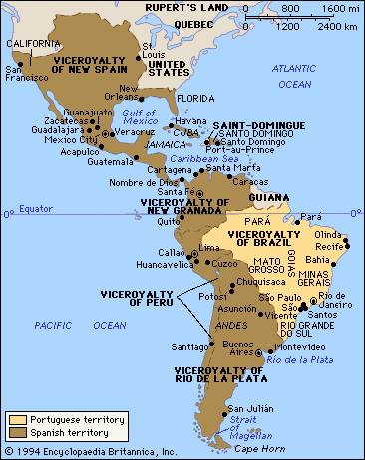
Spanish and Portuguese America, 1784

Slide 3
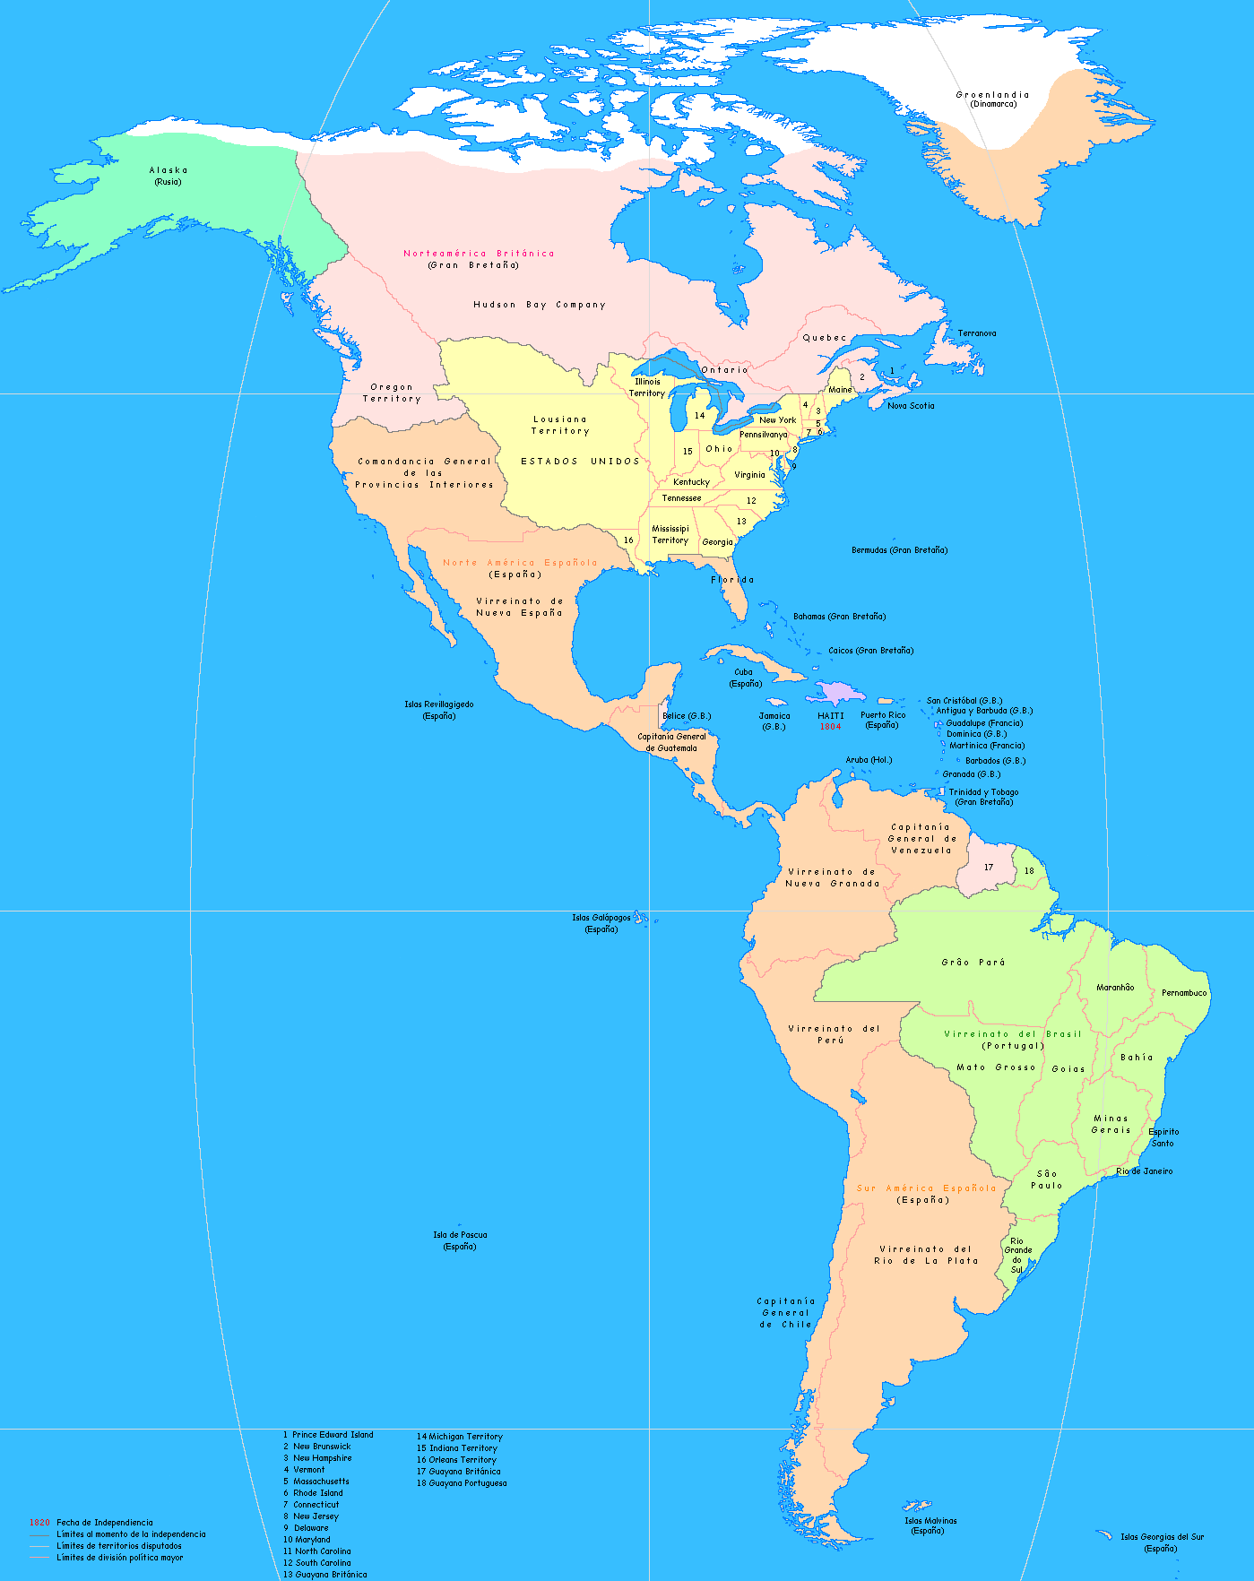
The Americas in 1810
United States’ 1776 war of independence resonated throughout the Americas. Napoleon’s occupation of Spain in 1808 triggered independence movements in Spanish America. In 1810, when Spanish resistance to Napoleon was about to collapse completely, Creole Americans in Mexico, Venezuela, New Granada*, Argentina, and Chile launched independence movements.
*Viceroyalty of new Granada (1718-1819) included Colombia, Ecuador, Panama, Venezuela,Guyana, and parts of northwestern Brazil, northern Peru, Costa Rica and Nicaragua.

Slide 4
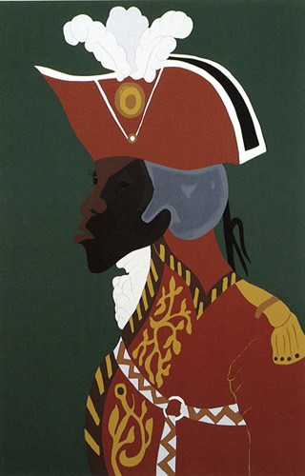
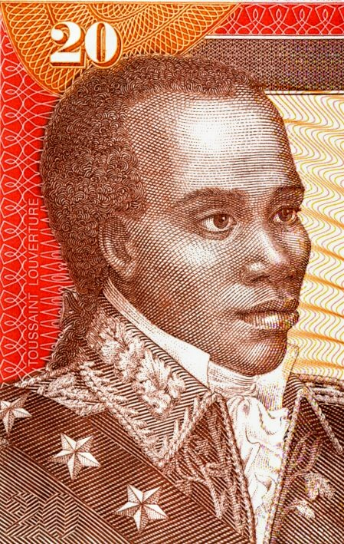
Haitian Revolution (1791–1804)
Jacob Lawrence (US. 1917-2000) General Toussaint L'Overture, 1986, silkscreen on 2-ply rag paper, 28 3/8 x 18 1/2 inches
Haitian bank note with portrait
of Toussaint L’Overture

Slide 5
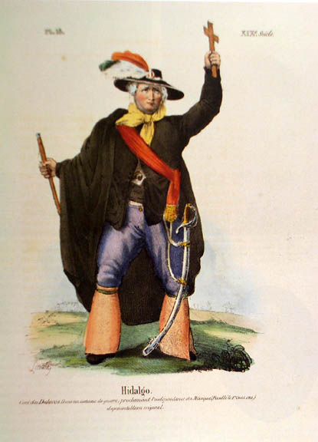
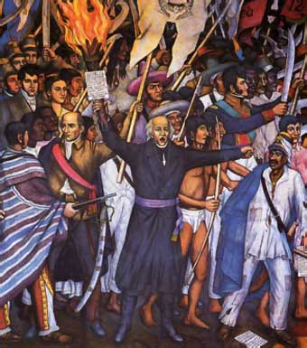
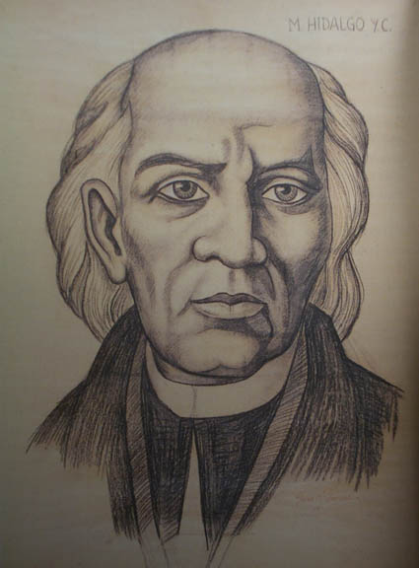
(left) Claudio Linati, Miguel Hidalgo, from Costumes du Mexique, Brussels, 1828
(center and right) Juan O’Gorman (Mexican, 1905-1982), detail from Chapultepec Castle (now National Museum of History, Mexico City) mural showing Hidalgo, c.1944; Portrait of Miguel Hidalgo, n.d., preparatory study for mural, charcoal on paper
Hidalgo, a parish priest, initiated the 1810 indigenous uprising against Spain. However: “Both culturally and economically, Independence was for the creoles, not the Indians.” (Ades)
Hidalgo: “Father of Mexico”

Slide 6
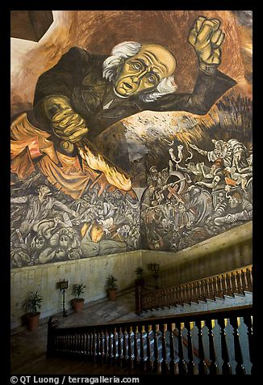
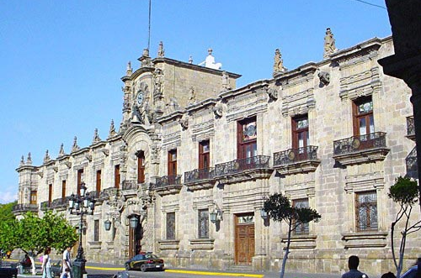
Stairway roof with portrait of Miguel Hidalgo by Jose Clemente Orozco in the Palacio del Gobierno. Guadalajara, Jalisco, Mexico, 1937, fresco

Slide 7
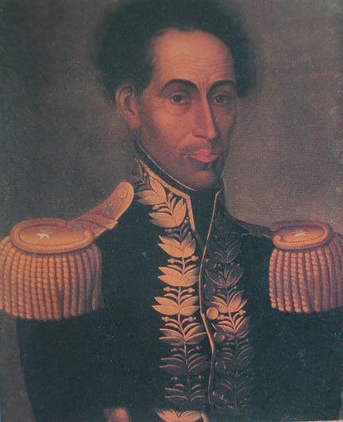
Antonio Salas (attributed), Portrait of Simon Bolivar 1829, o/c, 23” x 18”. Bolivar (1783-1830), from a wealthy Venezuelan creole family, led independence wars in the present nations of Venezuela, Colombia, Panama, Ecuador, Peru, and Bolivia, gaining independence for most of the northern part of South America
“It will be said that I have liberated the new World, but it will not be said that
I perfected the stability and happiness of any of the nations that compass it.”
“We have ploughed the sea”
Bolivar

Slide 8
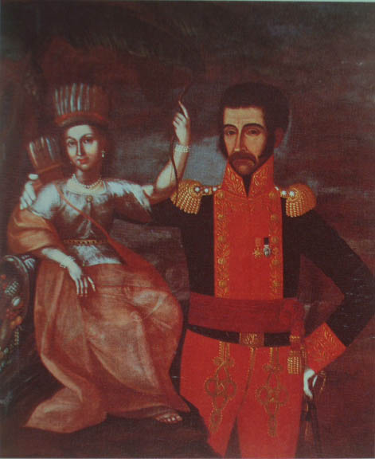
Pedro José Figueroa, Simon Bolivar, Liberator and Father of the Nation, 1819, oil on canvas, Quinta de Bolivar, Colombia.
Note the Indian woman with feather headdress, bow and arrows as “America” or the New Republic

Slide 9
Academies and History Painting
The Royal Academy of San Carlos in Mexico City, founded in 1785, was the first academy of art in America, and the only one established under colonial rule.
In Brazil, the Academia Imperial de Belas Artes was founded in Rio de Janeiro in 1826 with the French painter J.B. Debret, who trained in [Paris at Jacques Louis] David’s studio, as director.
In Peru, the Academy was founded in 1919” (coinciding with the arrival of modern art).

Slide 10
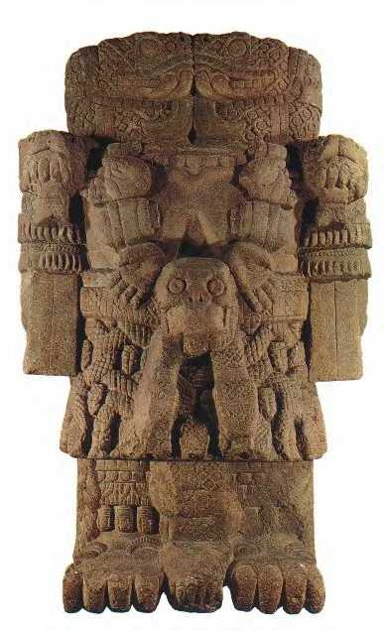
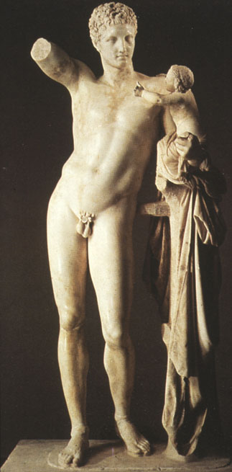
(left) Aztec goddess, Coatlique, c. 1500 C.E. re-discovered in 1790, Mexico City; (right) Praxiteles, Hermes & Dionysus, Greek, 4th Century B.C.
The Royal Academy of San Carlos in Mexico City was thoroughly European in its aims and practices. Students studied from a selection of plaster casts of Greek and Roman sculptures sent from Spain. The question of the “beauty” of European versus ancient Indigenous Mexican work was discussed.

Slide 11
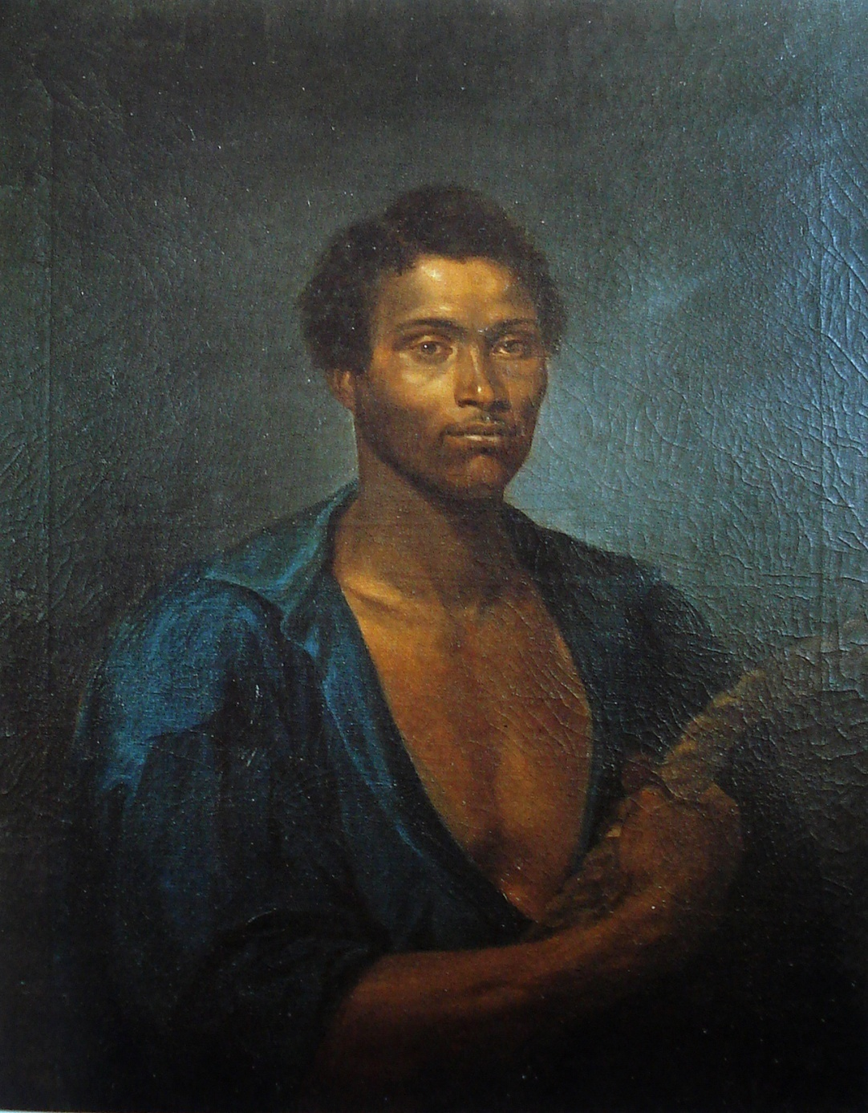
José Correia de Lima (Rio de Janeiro, 1814 -1857) Portrait of Simon the Sailor, c. 1855, oil on canvas, 37 x 29 inches. One of first academic portraits of an African-Brazilian.

Slide 12
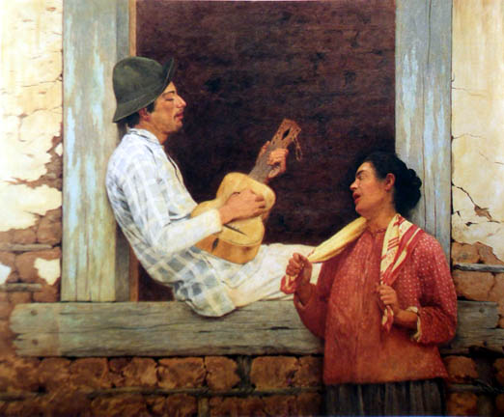
José Ferraz de Almeida Júnior (Brazil, 1859-1899), The Guitar Player, 1899, o/c, 56” H, Pinocoteca do Estado de Sao Paolo Academic genre paintings “costumbrismo” and “realism”

Slide 13
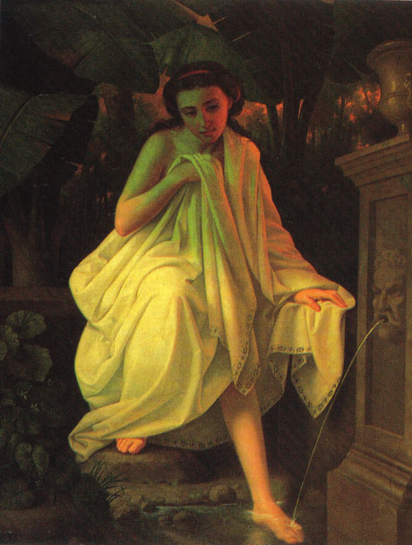
Juan Cordero (Mexico, 1824-1884), The Bather, c.1860, oil on canvas, 59 X 45 in.
Cordero’s draped nude shocked Mexican visitors at a 1864 exhibition.

Slide 14
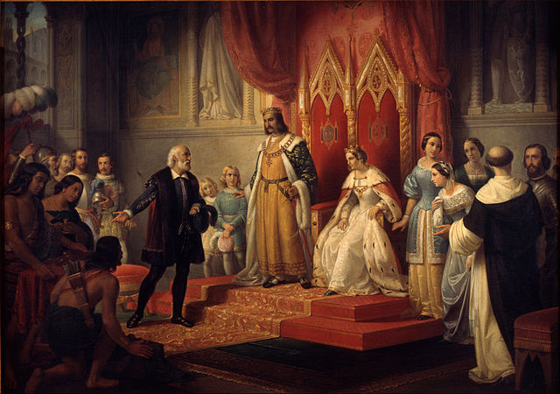
Juan Cordero (Mexico, 1824-1884), Columbus Before the Catholic Monarchs, 1850, o/c, 68” H.
First history painting of an American subject created for Mexican viewers.
Academic history paintings were popular in the Americas as propaganda for self-determination of national identity.

Slide 15
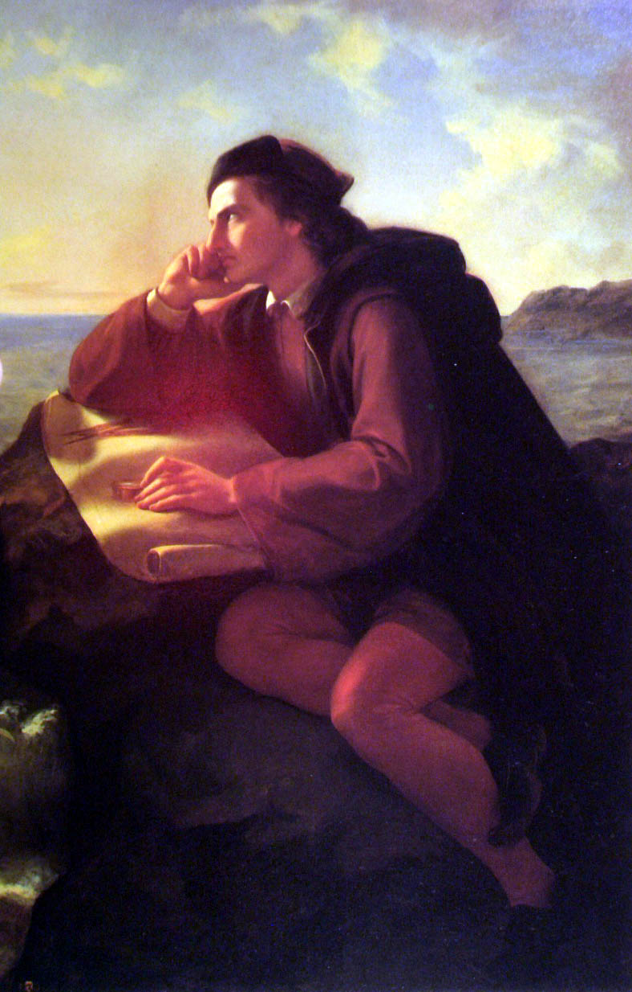
José Maria Obregón, The Inspiration of Columbus, 1856, oil, 58” high

Slide 16
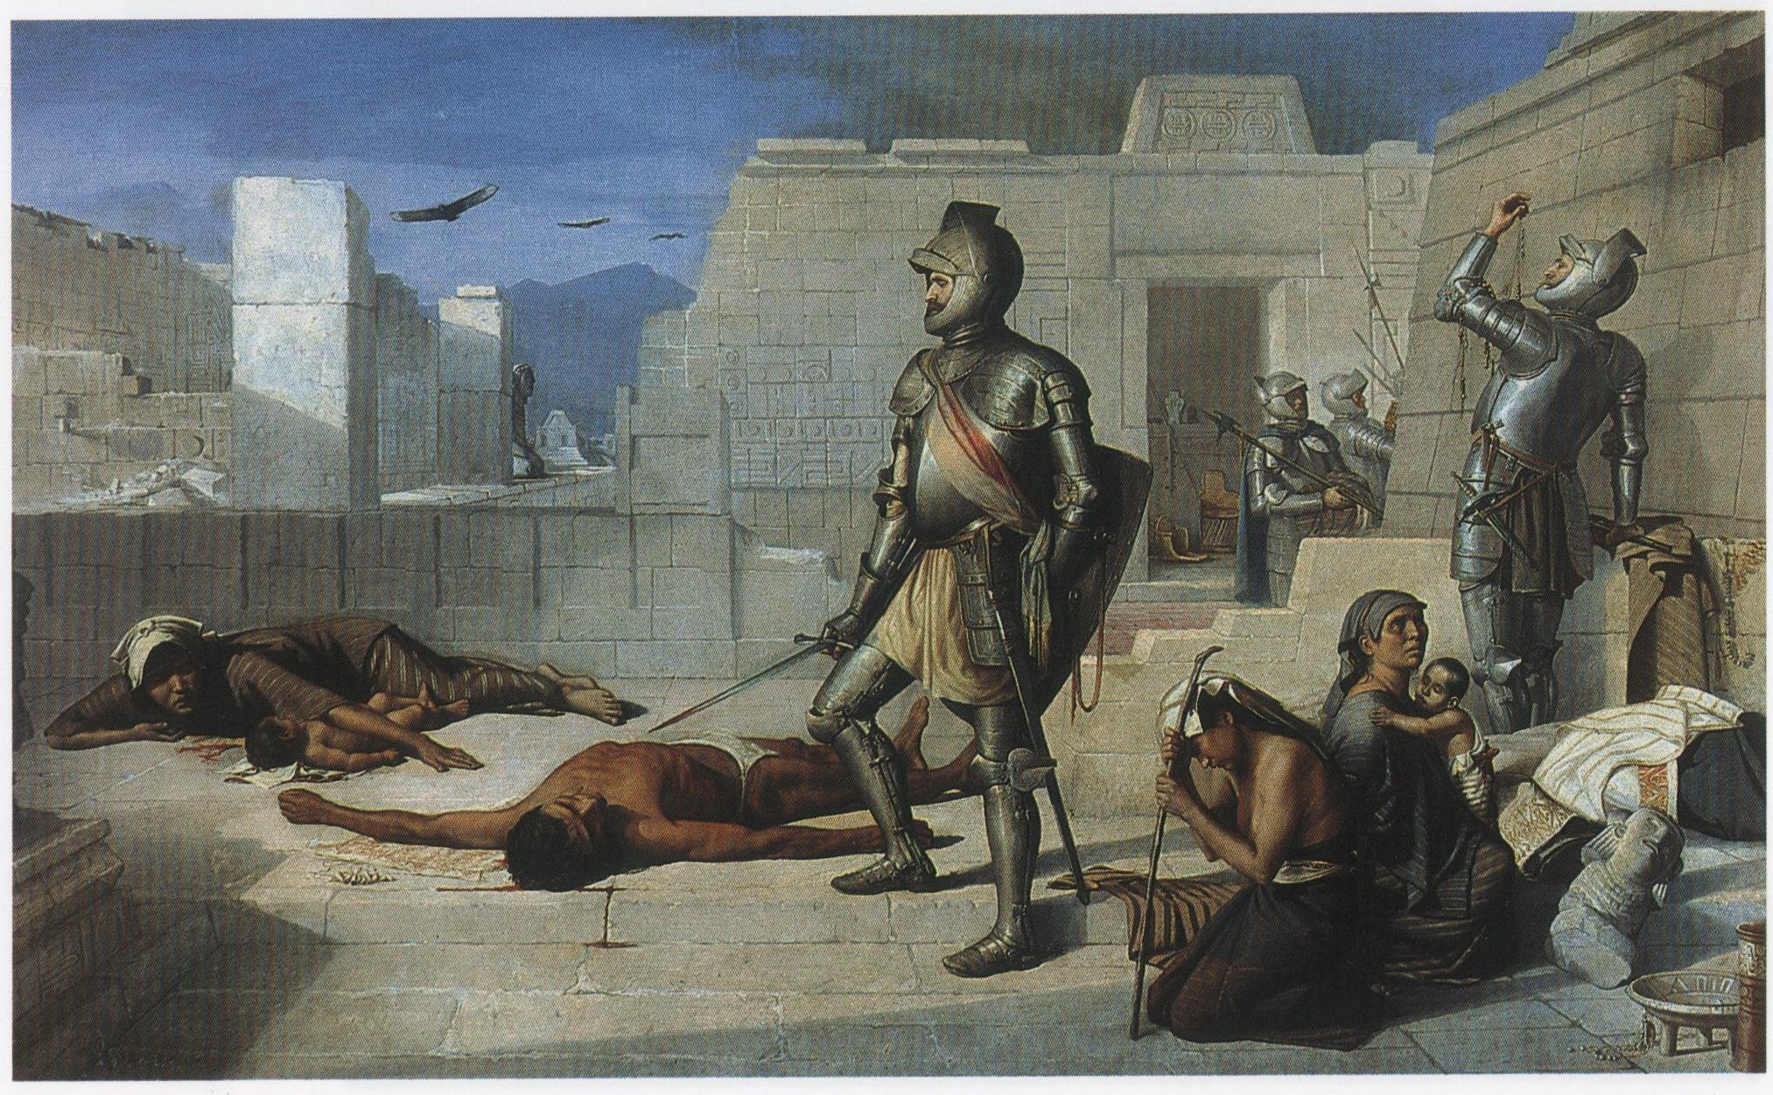
Felix Parra, The Massacre of Cholula, 1877, oil on canvas, 31 x 41 inches, National Museum of Art, Mexico City. Parra’s painting documents an incident of appalling genocide ordered by Cortes in 1519 as described in Brevísima Relación de la Destrucción de las Indias (1552) by the Spanish missionary Fray Bartolomé de las Casas.
Subjects are “objects of paternalism typical of 19th century writing about the contemporary Indian.”

Slide 17
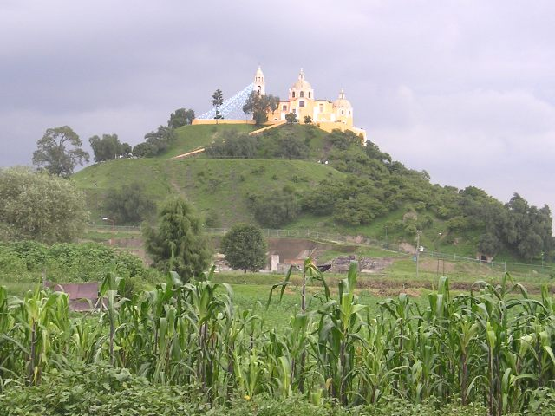
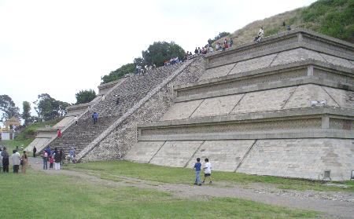
Cholula, a Mexican city second only to Tenochtitlan in 1519 and the arrival of Cortes. The largest man-made monument in the world, the great temple of Quetzalcoatl at Cholula from a distance looks like a small mountain with a Catholic cathedral at the crest.
(right) a fraction of a staircase on one side of the pyramid has been restored to its former state.

Slide 18
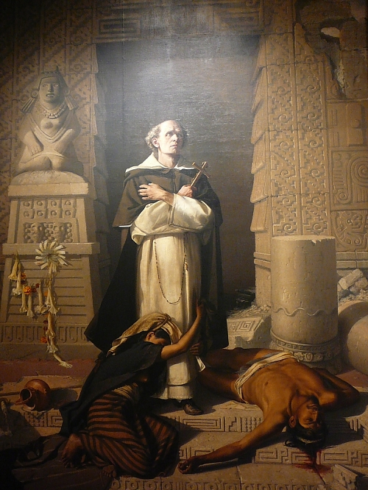
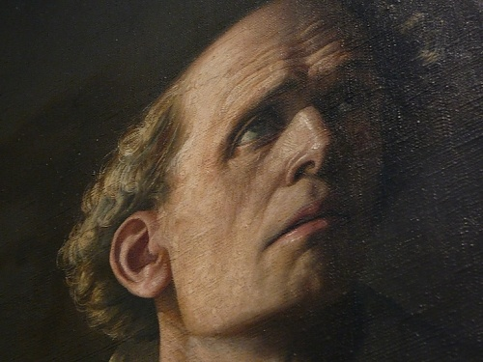
Felix Parra, Friar Bartolomé de las Casas, 1875, oil on canvas, Museo Nacional de Arte, Mexico City. The woman turns to the Christian friar and not the “Aztec” god.

Slide 19
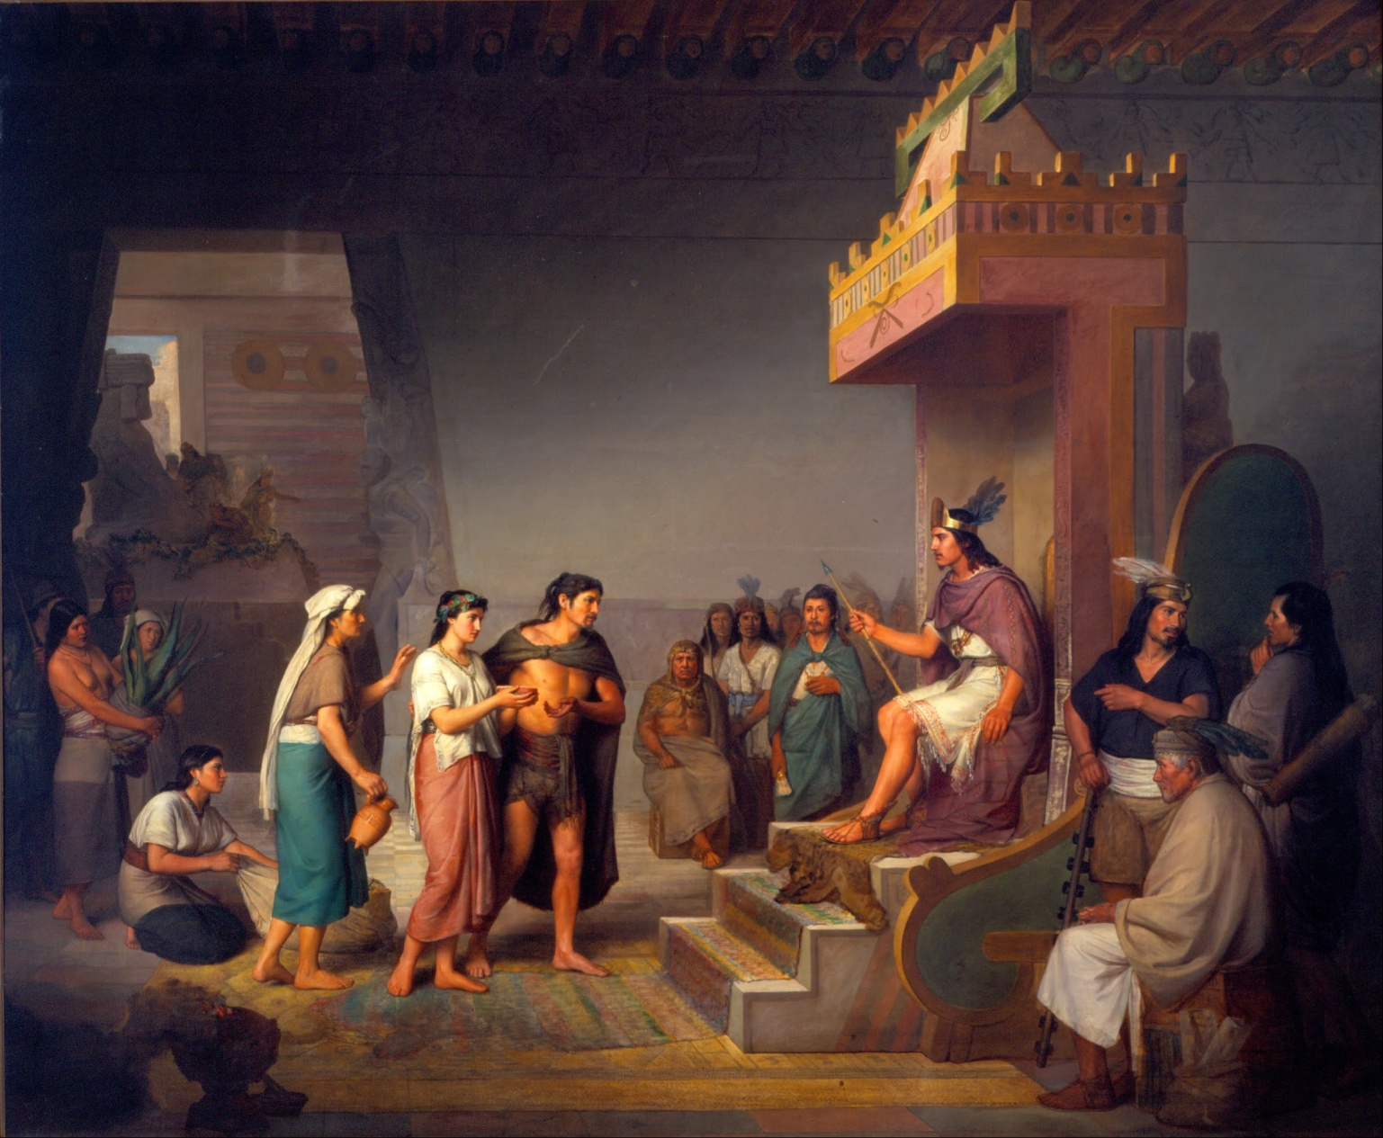
José Maria Obregón, Discovery of Pulque, 1869, oil on canvas, 73 x 91 in. The painting illustrates native historian Fernando de Alva Ixtlilxochitl's description of Xochitl (so cheel) as a beautiful virgin brought to Tecpancaltzin (tec pahn cal ztin) by her father, Papatzin. Papatzin was a Toltec noble and a cultivator of maguey plants. Xochitl and/or her father invented pulque, made from maguey.
Academic Neoclassicism in Mexico. European “throne scene” and Europeanized features, lightened skin, “Greek” postures, all meant to appeal to the audiences for and patrons of academic painting.

Slide 20
Natalia Majluf, “Ce n’es pas le Peru,” or, the Failure of Authenticity:
Marginal Cosmopolitans at the Paris Universal Exhibition of 1855”
“The movement of artists and intellectuals from Latin America to metropolitan centers (and usually back) increased dramatically after independence from Spain in the early nineteenth century…young Creole Americans traveled to Paris, London, and Rome not as exiles or émigrés but as cosmopolitans, as participants in a world culture.”
“…but the international community has systematically rejected any sign of their sameness.”

Slide 21
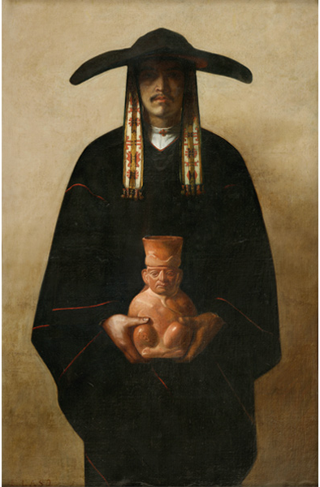
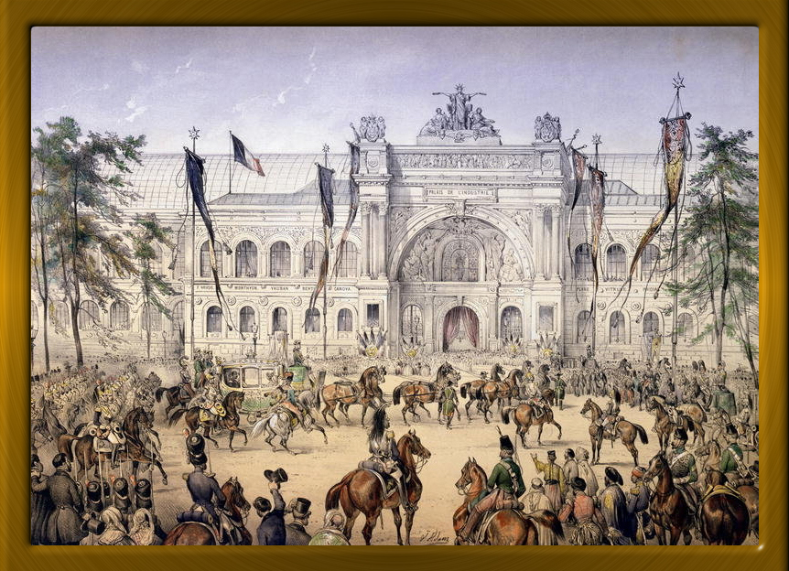
Francisco Laso, The Indian Potter (Dweller in the Cordillera) 1855, o/c, 4’4” H., Lima
“The same comparative context that rejected the cosmopolitanism of the Latin American artists served simultaneously to locate France at the very center of the international art scene.”
Natalia Majluf
The French Universal Exhibition of 1855, Palace of Industry

Slide 22
Francisco Laso, Portrait of Gonzalo Pizarro, One of the Most Famous Conquerors of Peru, Brother of Francisco Pizarro,
1855. Oil on canvas, 76 x 58 cm. Banco Central de Reserva, Lima.

Slide 23
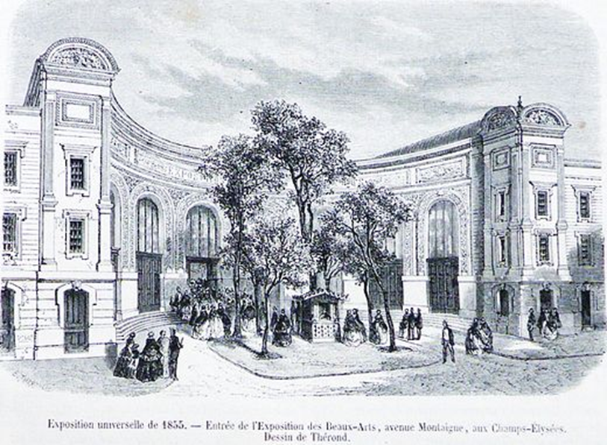
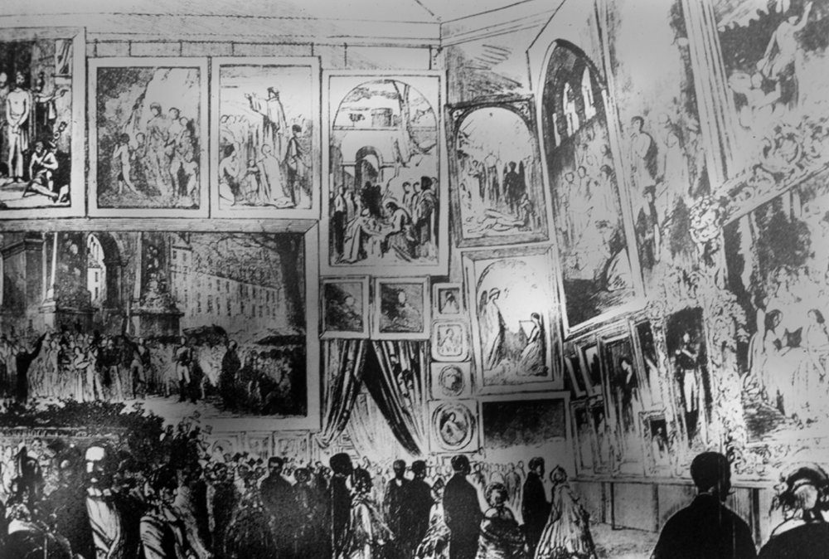
French Universal Exhibition of 1855: (left) exterior of the Palace of Fine Arts; (right) one of the exhibition galleries (salon-style display of paintings)

Slide 24
“Why is this habitant carrying a
piggybank? Without a doubt it is
To indicate how rich his country
Is. This is true, but, for painting,
this is not Peru (ce n’est pas le Pérou).”

Slide 25
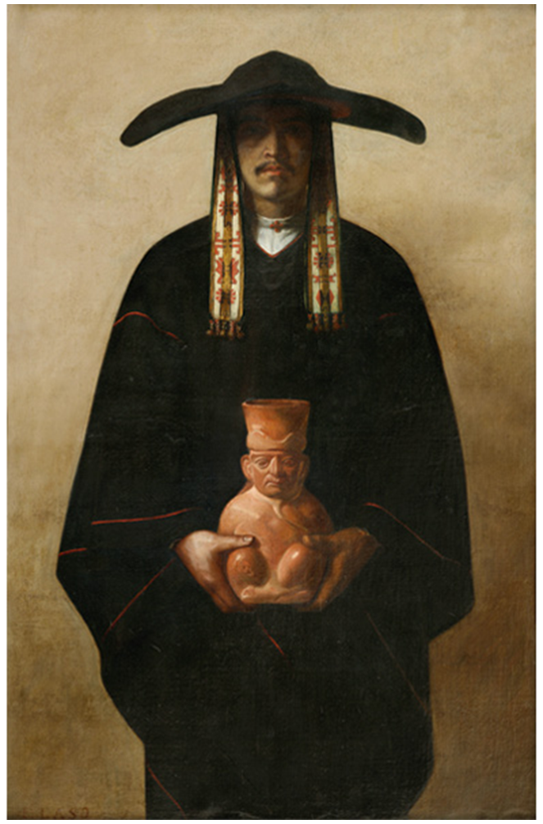
A.Marc, "Peruvian school.-Inhabitants of the Cordilleras, painting by Mr. E Laso." From L’Illumination, journal universel (1855)

Slide 26
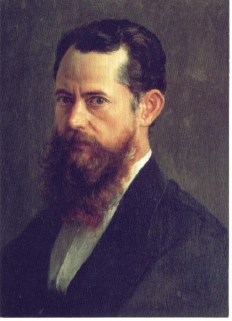
José María Velasco (Mexican,1840-1912) Self Portrait, 1894, oil on canvas, 22 x 16.5”, Museo Nacional de Arte de México

Slide 27
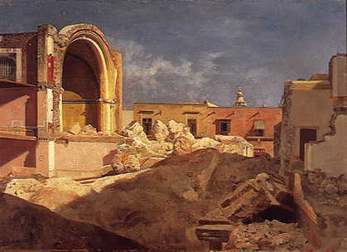
José María Velasco, Templo de San Bernardo (San Bernardo Church), 1861, oil on paper mounted on canvas, 13 X 17 ½ inches
A study Velasco did as a student at the Academy San Carlos in Mexico City. It shows the destruction of a church to create city boulevards. Modernization of Mexico is documented in Velasco’s oeuvre with obvious ambiguity.

Slide 28
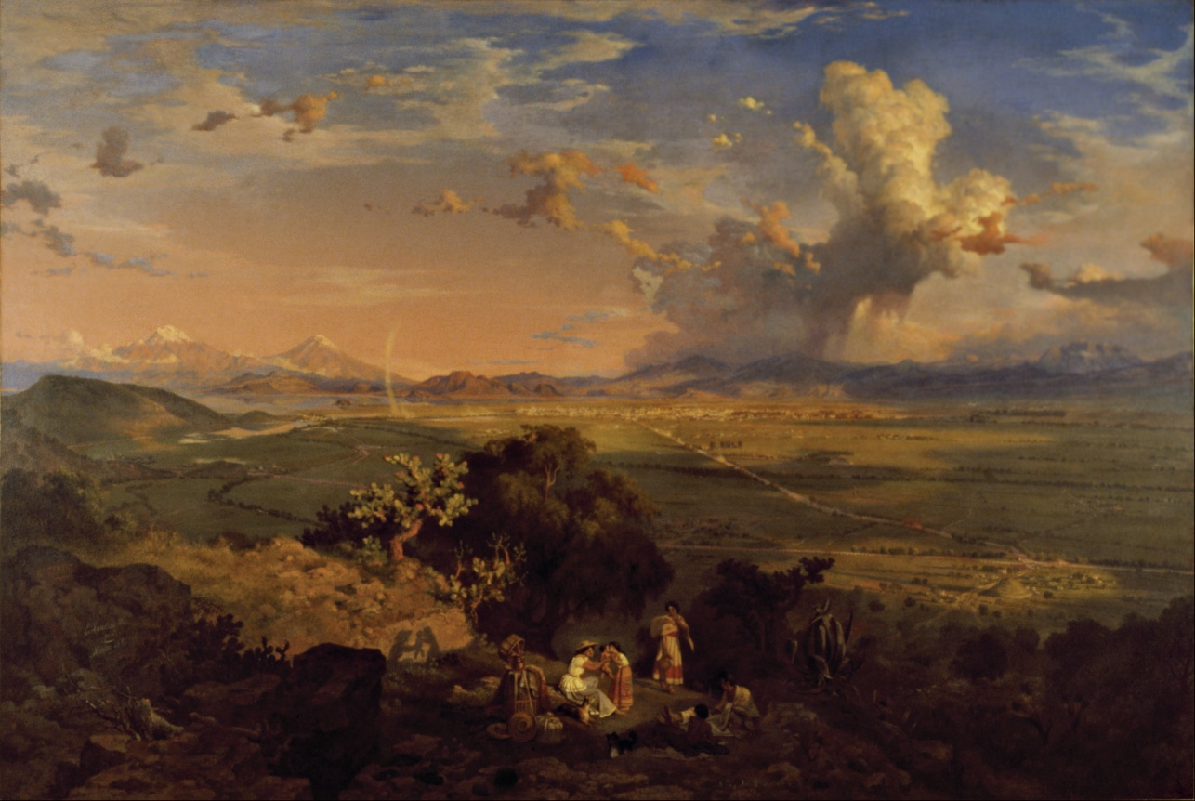
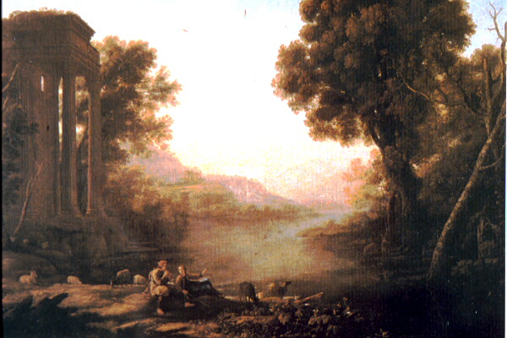
(right) Eugenio Landesio (Italian active in Mexico City), The Valley of Mexico, n.d., oil on canvas, Museo Nacional de Arte, Mexico City. Velasco’s teacher at the Academy of San Carlos painting is in the 17th century tradition of Claude Lorraine
(left) Claude Lorraine (French, 1604-1682), Pastoral Landscape 1638

Slide 29
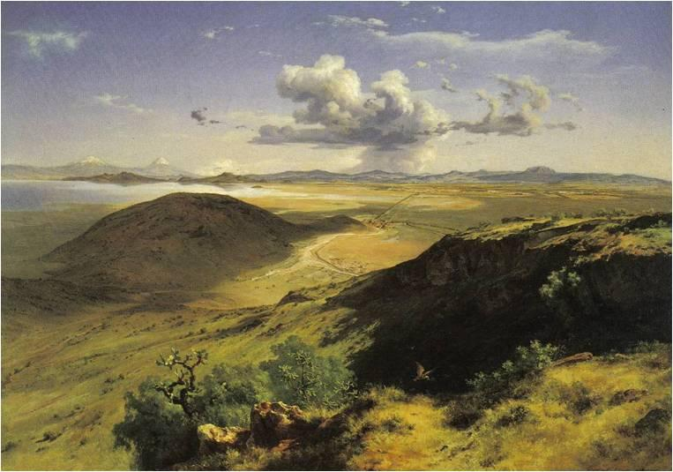
José María Velasco, View of the Valley of Mexico from the Hill of Santa Isabel, 1877, oil on canvas, 90 inches across, Museo Nacional de Arte, Mexico City. Velasco’s most famous painting. Compare with Eugenio Landesio, The Valley of Mexico. Note “wild and rugged features which resist the smoothing and unifying eye” (Ades)

Slide 30
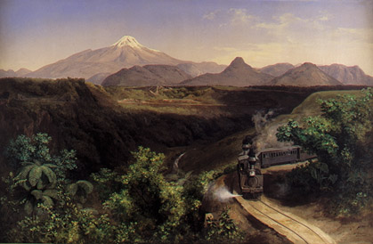
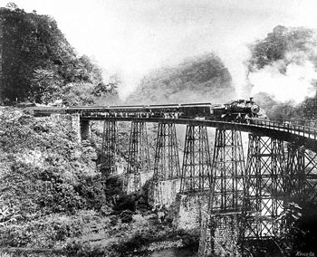
Velasco, Metlac Ravine, Viewed from Near the Station in Fortin, 1897, o/c, 41” h
(right) anonymous photograph of Metlac ravine, 1910
Modernization of Mexico

Slide 31
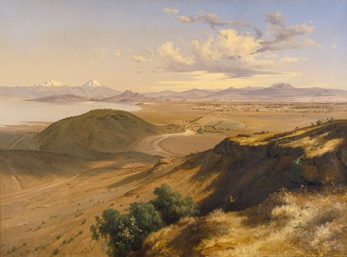
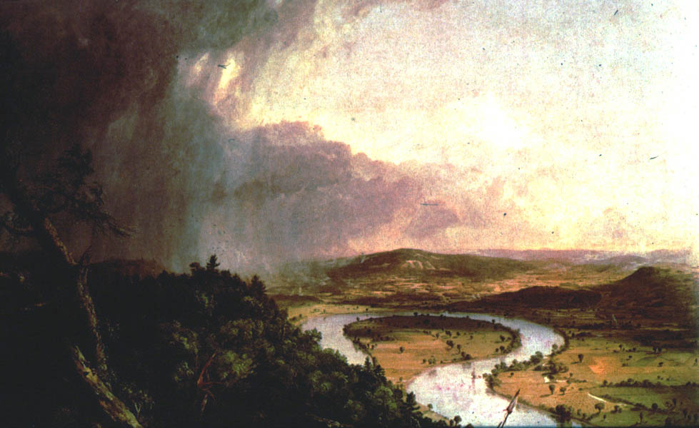
José Maria Velasco, Valley of Mexico from the Hill of Santa Isabel, 1877, o/c, 5’3”x7’6” – site of Mexico City, and the Teotihuacan, Toltec and Aztec civilizations
(right) Thomas Cole (English-American, 1801-1848, Hudson River School) View from Mt. Holyoke, Northampton, Massachusetts, after a Thunderstorm (The Oxbow), 1836

Slide 32
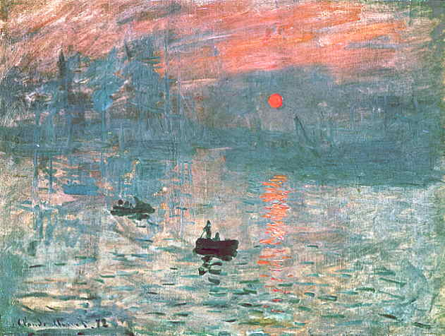
Velasco exhibited 68 paintings in Paris at the Universal Exposition of 1889 and saw Impressionism for the first time and painted a few Impressionist landscapes in Paris, but he remained an academic painter.
Claude Monet (French Avant-garde Impressionist), Impression, Sunrise, 1872, oil on canvas,
18.9 x 24.8 inches, Musée Marmottan Monet, Paris. Avant-garde modernism was anti-academic.

Slide 33
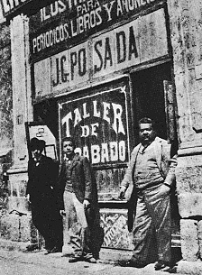
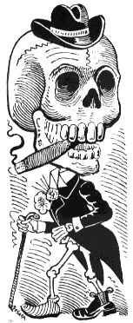
José Guadalupe Posada
(Mexican printmaker,1852-1913)

Slide 34
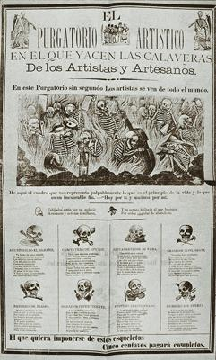
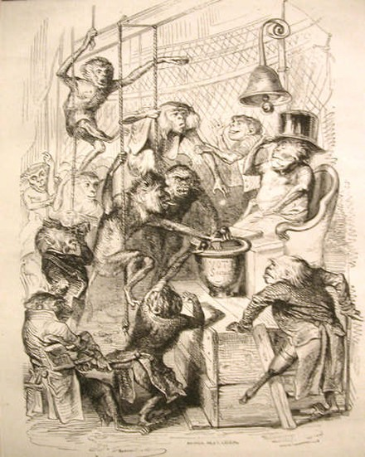
(left) José Guadalupe Posada (Mexican, 1852-1913), Artists’ Purgatory
(right) J.J.Grandville (Jean Ignace Isidore Gérard, French, 1803-1847) Chamber of Deputies, 1867, engraving

Slide 35
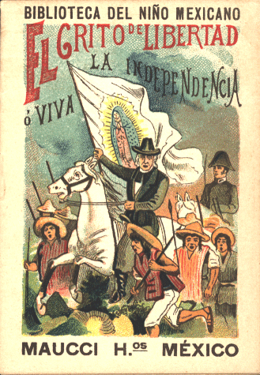
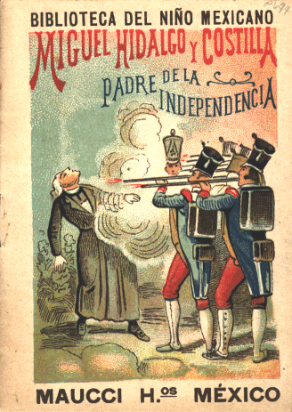
In 1900 Maucci Brothers, a Spanish publisher, commissioned Posada to illustrate a series of pamphlets for children on the history of Mexico. Each pamphlet measuring 4 3/4 x 3 1/4 in. is approximately 16 pages. The cover illustrations are probably the only mechanically produced chromolithographs that Posada ever did. Jean Charlot collection, University of Hawaii

Slide 36
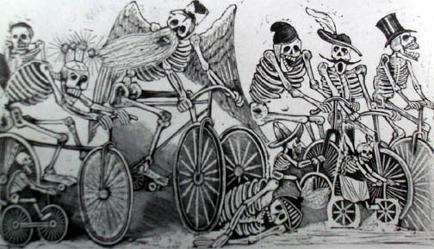
José Guadalupe Posada, Calavera of the Newspapers, 1889-95 type metal engraving, MoMA NYC

Slide 37
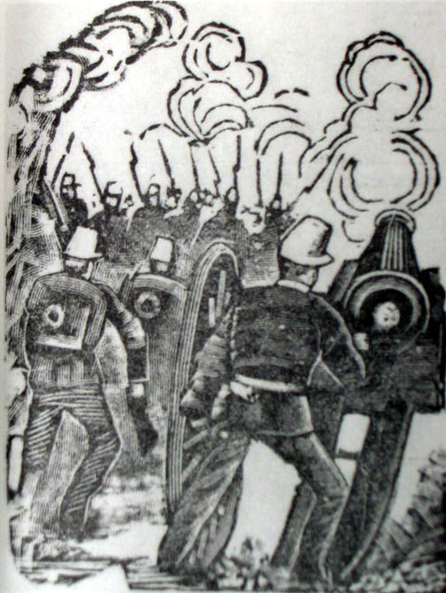
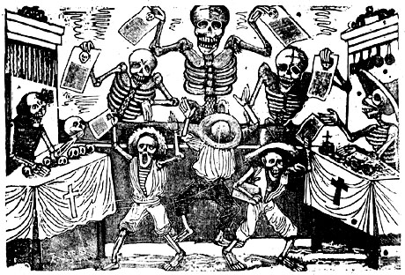
Posada, Streets of the City of Mexico on the Morning of 9 February 1913, n.d., zinc engraving,
(right) Skeletons at a fractional price as never seen before in all of the Capital.

